Slide 1
Simplifying Census data
Interactive visualization of 2011 Census Data
MTH-208 PROJECT
GROUP-22
Adeeba Yusuf
Parvez Khan
Tanay Pathode
Project guide:
Dr. Dootika Vats

Slide 2
Data Collection
The data was collected from :
https://www.census2011.co.in/district.php
https://www.census2011.co.in/states.php
https://github.com/datameet/maps/tree/master/Survey-of-India-Index-Maps/Boundaries

Slide 3
Where can our App help?
Key Features:
Education Advocacy: Visualize literacy rates, target low-literacy regions, and track program progress.
Healthcare Planning: Identify areas with low sex ratios or high population density for health initiatives.
Impact: Empower government organizations to deploy educational resources and help them in strategic health and education planning.

Slide 4
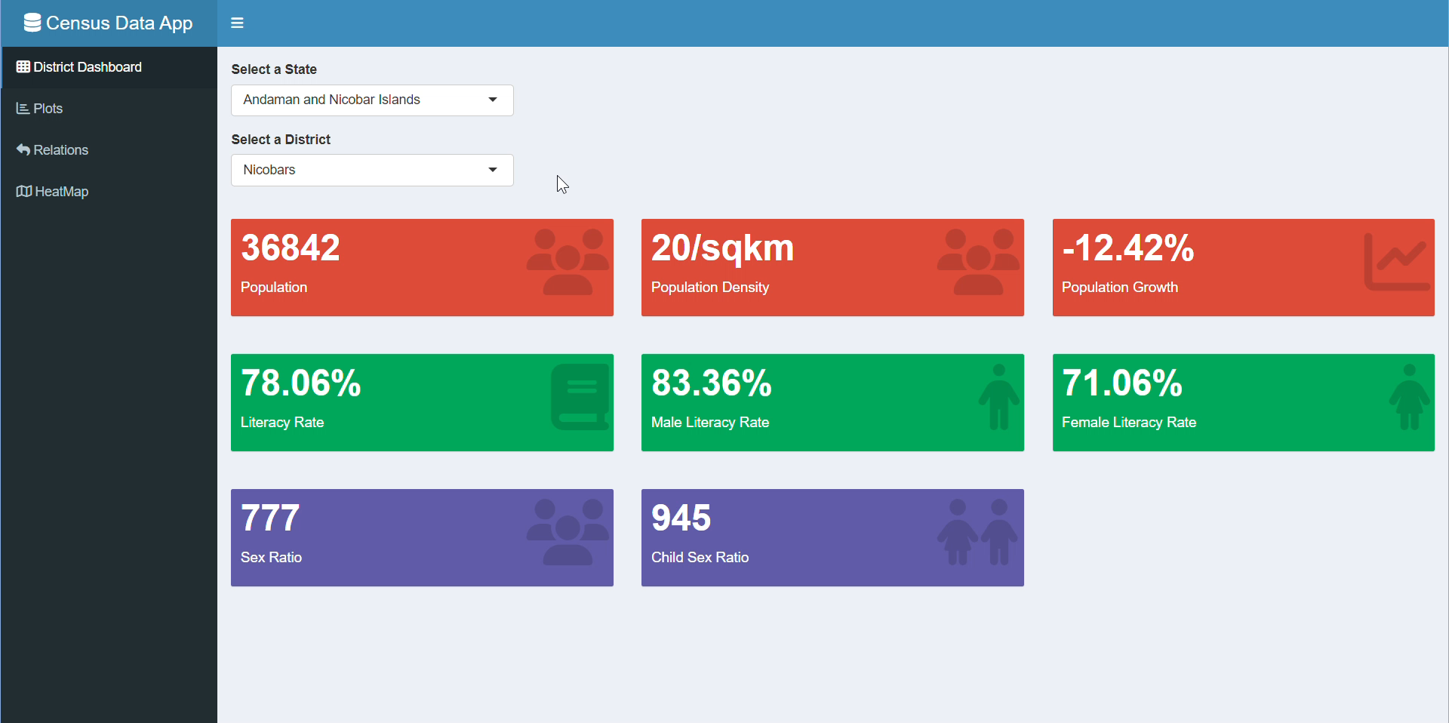

Slide 5
Thank You !!

